Slide 1

Warby Parker marketing funnel
Learn SQL from Scratch
Saki Takasu
January 2019

Slide 2
Example Table of Contents
Background : Warby Parker’s survey and home trial
Quiz Funnel
Home Try-On A/B Test
Summary

Slide 3
1. Background : Warby Parker’s survey and home trial

Slide 4
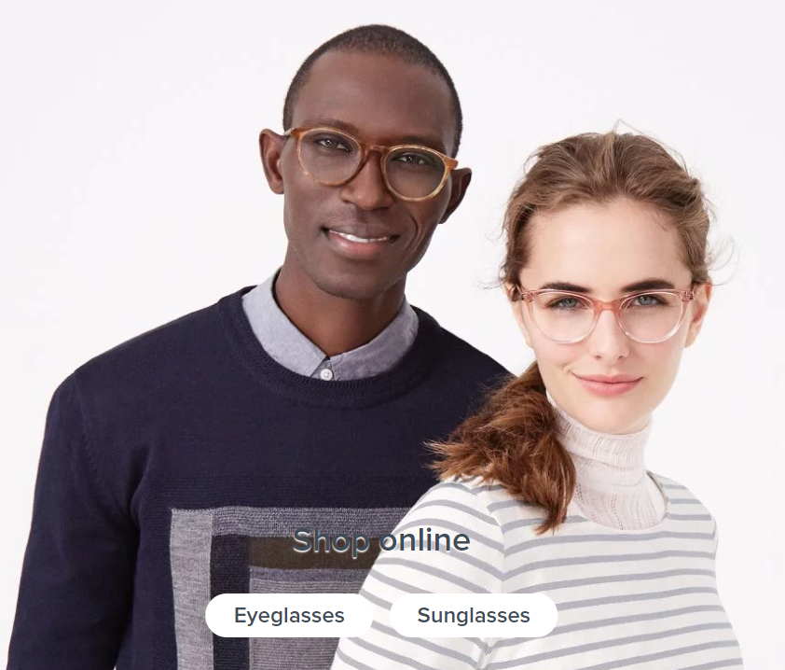
Warby Parker’s survey and marketing funnel
Warby Parker is a transformative lifestyle brand with a lofty objective: to offer designer eyewear at a revolutionary price while leading the way for socially conscious businesses.
The marketing team would like to measure the effectiveness of Warby Parker’s online survey that helps customers narrow down trial preferences, lead to home trials and eventually a purchase.
We will look at the Quiz funnel to understand user drop-off and the Home Try-On funnel to understand the impact of 3 pair vs 5 pair trials.

Slide 5
2. Quiz Funnel

Slide 6
2.1 Style Quiz
To help users find their perfect frame, Warby Parker has a Style Quiz that has the following questions:
"What are you looking for?"
"What's your fit?"
"Which shapes do you like?"
"Which colors do you like?"
"When was your last eye exam?“
The responses are captured in a survey data table with columns for Question, User ID, and Response. The marketing team analyzed the completion of the survey questions through each stage and potential weaknesses in the questions where there was higher drop-off.

Slide 7
2.1 Style Quiz data table - sample
Question | User_id | Response
1. What are you looking for? | 005e7f99-d48c-4fce-b605-10506c85aaf7 | Women's Styles
2. What's your fit? | 005e7f99-d48c-4fce-b605-10506c85aaf7 | Medium
3. Which shapes do you like? | 00a556ed-f13e-4c67-8704-27e3573684cd | Round
4. Which colors do you like? | 00a556ed-f13e-4c67-8704-27e3573684cd | Two-Tone
1. What are you looking for? | 00a556ed-f13e-4c67-8704-27e3573684cd | I'm not sure. Let's skip it.
2. What's your fit? | 00a556ed-f13e-4c67-8704-27e3573684cd | Narrow
5. When was your last eye exam? | 00a556ed-f13e-4c67-8704-27e3573684cd | <1 Year
3. Which shapes do you like? | 00bf9d63-0999-43a3-9e5b-9c372e6890d2 | Square
5. When was your last eye exam? | 00bf9d63-0999-43a3-9e5b-9c372e6890d2 | <1 Year
2. What's your fit? | 00bf9d63-0999-43a3-9e5b-9c372e6890d2 | Medium

Slide 8
2.2 Survey funnel (1 of 2)
Responses per question reveal when the users dropped off in answering survey questions. Based on this funnel result, we have identified that only 475 out of 500 respondents continued from question 1 to 2 (or 95%). The other completion rates are listed below.
SQL Code:
SELECT question, COUNT(response)
FROM survey
GROUP BY 1;
Question | Responses | Completion rate % (compared to previous question)
1. What are you looking for? | 500 | -
2. What's your fit? | 475 | 95%
3. Which shapes do you like? | 380 | 80%
4. Which colors do you like? | 361 | 95%
5. When was your last eye exam? | 270 | 75%

Slide 9
2.2 Survey funnel (2 of 2)
Questions 5 and 3, respectively, have low completion rates.
Drop-off at question 5 could be due to survey question fatigue and inability for users to recall when their last eye exam was
Drop-off at question 3 could be due to users having many different options, causing hesitation in responding or wanting to come back later
Potential ways to increase conversion is to include a short text at the bottom to encourage users to complete the question, such as “We’ll take your best guess!” to Q5 and “You can always choose different styles later” for Q3
SQL Code:
SELECT question, COUNT(response)
FROM survey
GROUP BY 1;
Question | Responses | Completion rate % (compared to previous question)
1. What are you looking for? | 500 | -
2. What's your fit? | 475 | 95%
3. Which shapes do you like? | 380 | 80%
4. Which colors do you like? | 361 | 95%
5. When was your last eye exam? | 270 | 75%

Slide 10
3. Home Try-On A/B Test

Slide 11
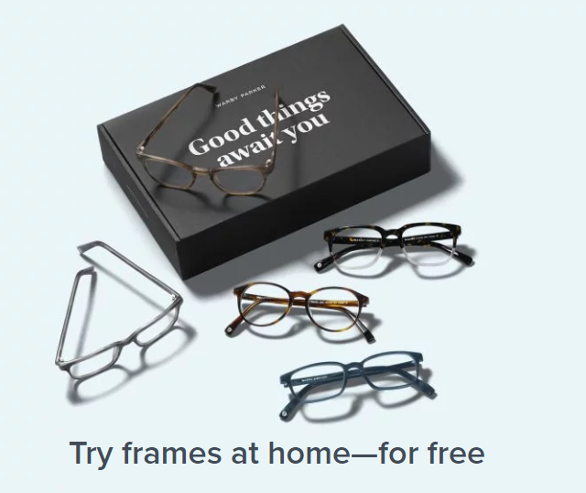
3.1 A/B testing for home try-on
Customers that have taken the quiz can now try on different glasses at home. We will now conduct an A/B test on the conversion rate of users who try on 3 pairs vs 5 pairs.
In our sample data set:
50% of the users received 3 pairs to try on
50% of the users received 5 pairs to try on

Slide 12
3.2 Database schema for Quiz, Home_Try_On, Purchase
The following data tables were combined to create the Home Try-On funnel:
Quiz
User_id
Style
Fit
Shape
Color
User_id | is_home_try_on | number_of_pairs | is_purchased
4e8118dc-bb3d-49bf-85fc-cca8d83232ac | 1 | 3 pairs | 0
291f1cca-e507-48be-b063-002b14906468 | 1 | 3 pairs | 1
75122300-0736-4087-b6d8-c0c5373a1a04 | 0 | 0 | 0
75bc6ebd-40cd-4e1d-a301-27ddd93b12e2 | 1 | 5 pairs | 0
ce965c4d-7a2b-4db6-9847-601747fa7812 | 1 | 3 pairs | 1
Home_try_on
User_id
Number_of_pairs
Address
SQL Code:
SELECT q.user_id, h.user_id IS NOT NULL AS 'is_home_try_on', h.number_of_pairs, p.user_id IS NOT NULL AS 'is_purchase'
FROM quiz q
LEFT JOIN home_try_on h
ON q.user_id = h.user_id
LEFT JOIN purchase p
ON p.user_id = q.user_id;
Purchase
User_id
Product_id
Style
Model_name
Color
Price

Slide 13
4. Summary

Slide 14
Summary: Quiz Funnel and Home Try-On A/B Test
Quiz Funnel
Overall, the Warby Parker’s online survey has a good completion rate with users are navigating through the questions at 75-95% completion in each stage
Areas of improvement are in questions 3 and 5 (“Which shapes do you like?” and “When was your last eye exam?”), which have lower completion rates
Consideration for marketing and website team: Possible improvement could be adding “nudge” texts in the quiz, such as “We’ll take your best guess!” for the eye exam question. Q5 is especially critical to make sure it leads to home trial
Home Try-On A/B Test
When comparing home trials with 3 pairs vs 5 pairs, 5 pairs had a higher conversion rate to purchase of 59.4%, 8.8 pts higher than with 3 pairs
Implication to marketing and operations: Marketing should further explore whether users want a default of 5 pairs or would like to have an option of 3 pairs. Operations should understand cost and process implications of switching to shipping 5 pairs.

